Slide 1


Lecture 4
Produced by Dr. Worldwide
Welcome to the 305
~
~

Slide 2

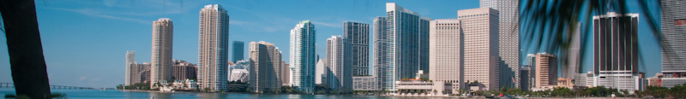


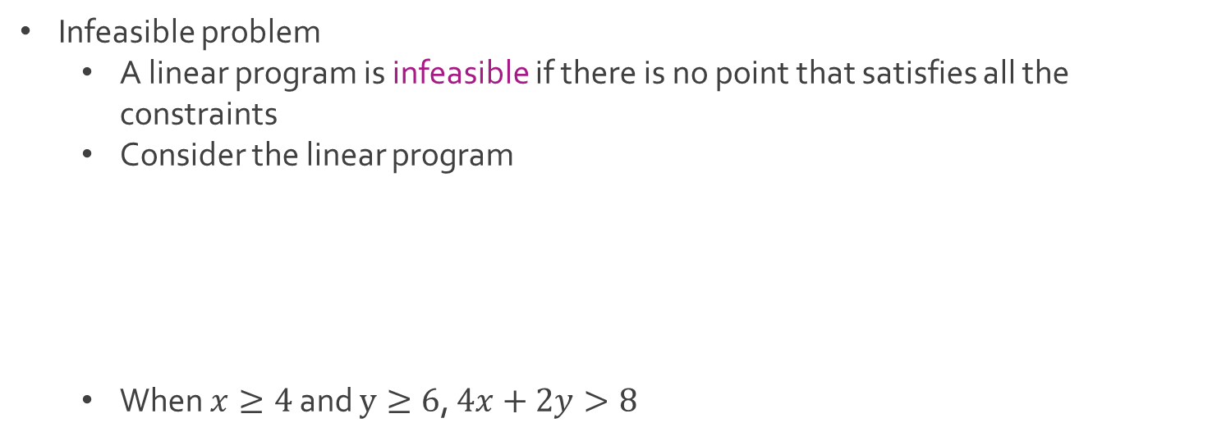

Special Cases
Infeasible problem
A linear program is infeasible if there is no point that satisfies all the constraints
Consider the linear program
When $x≥4$ and $y≥6$, $4x+2y>8$
Maximize $5x+3y$
Subject to $4x+2y≤8$
$x≥4$
$y≥6$
$$4\left(4\right)+2\left(6\right)=28>8$$
$$4\left(5\right)+2\left(7\right)=34>8$$

Slide 3
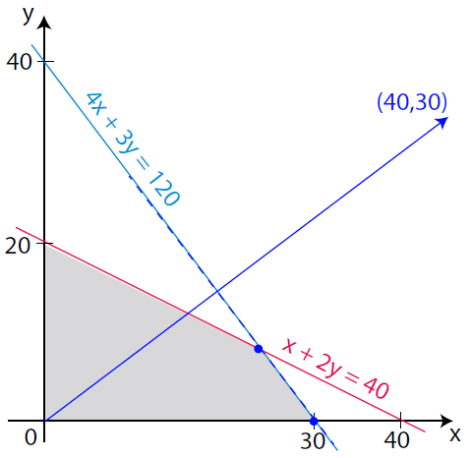




Special Cases
Multiple optimal solutions
A linear program may have multiple optimal solutions if there are two or more extreme points along the optimal level curve for the problem
Consider the linear program
Optimal points: $\left(24,8\right) \& (30,0)$
Maximize $40x+30y$
Subject to $x+2y≤40$
$4x+3y≤120$
$x≥0$
$y≥0$
$$40\left(24\right)+30\left(8\right)=1200$$
$$40\left(30\right)+30\left(0\right)=1200$$

Slide 4


Special Cases
Unbounded problem
A linear program is unbounded if the feasible region is not closed and the objective function grows (decreases) indefinitely without bound
Similar to the infeasible problem where no solution exists
Consider the two linear programs with identical feasible regions
Which linear program is unbounded, A or B?
A) Maximize $2x+y$
Subject to $x+y≥5$
$x≤4$
$x≥0$
$y≥0$
B) Minimize $2x+y$
Subject to $x+y≥5$
$x≤4$
$x≥0$
$y≥0$

Slide 5
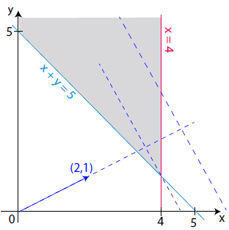

Special Cases
Unbounded problem
In both linear programs, the feasible region is unbounded
The maximization linear program is unbounded
The minimization linear program has a single optimal solution at $(0,5)$

Slide 6
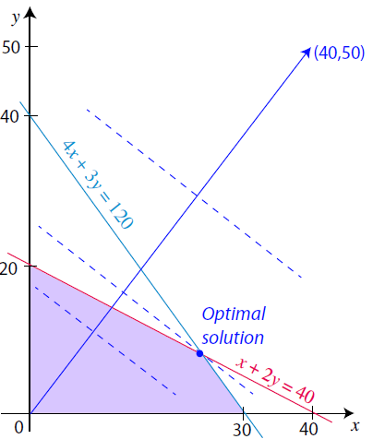

Computer Solution
Majority of linear programs solved using a computer
Excel’s built-in tool called Solver is capable of handling linear optimization using the simplex algorithm from George Dantzig
Recall: Beaver Creek Pottery Company from Lecture 2
Download BeaverCreek.xlsx from website link called Sheet 1
Linear Program
Optimal: 24 Bowls and 8 Mugs
Maximize $40x+50y$
Subject to $x+2y≤40$
$4x+3y≤120$
$x≥0$
$y≥0$

Slide 7
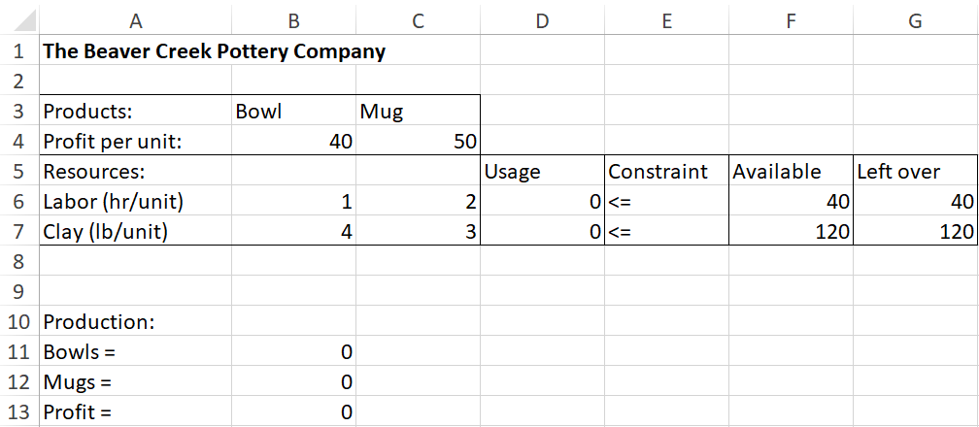
Computer Solution
Preview of Spreadsheet

Slide 8
Computer Solution
Preview of Spreadsheet
Objective Function: B4*B*11+C4*B12

Slide 9
Computer Solution
Preview of Spreadsheet
Labor Used: B6*B11+C6*B12
Clay Used: B7*B11+C7*B12

Slide 10
Computer Solution
Preview of Spreadsheet
Capacity

Slide 11
Computer Solution
Preview of Spreadsheet
Labor Waste: F6-D6
Clay Waste: F6-D6

Slide 12
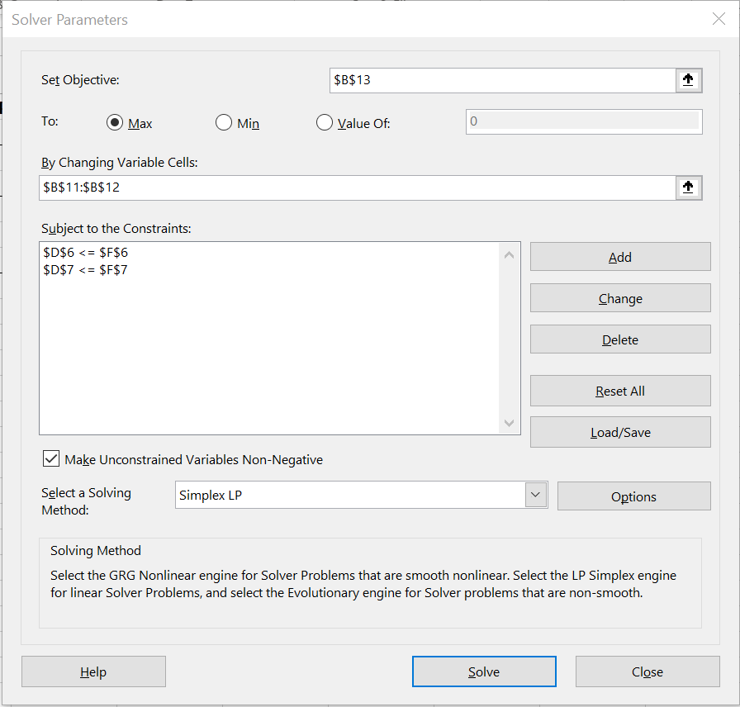
Computer Solution
Optimizing with Excel
Select Data and then select Solver by the Analyze section
Observe window

Slide 13


Computer Solution
Optimizing with Excel
Cell you are trying to optimize with objective function
Maximize or minimize
Choose your decision variables

Slide 14
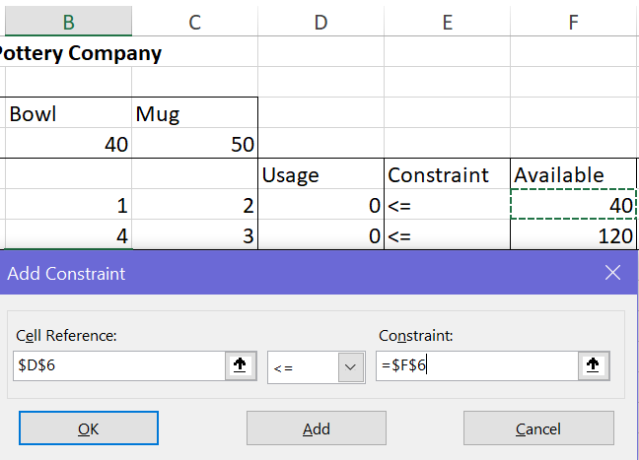
Computer Solution
Optimizing with Excel
Create your constraints using Add
You can type or click to select cell
You will see your constraints in the Subject to the Constraints
Notice box for nonnegativity

Slide 15

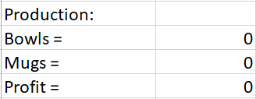
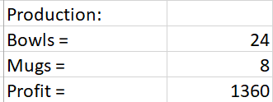
Computer Solution
Optimizing with Excel
Select Solve
Optimal solution can be found in decision variables

Slide 16
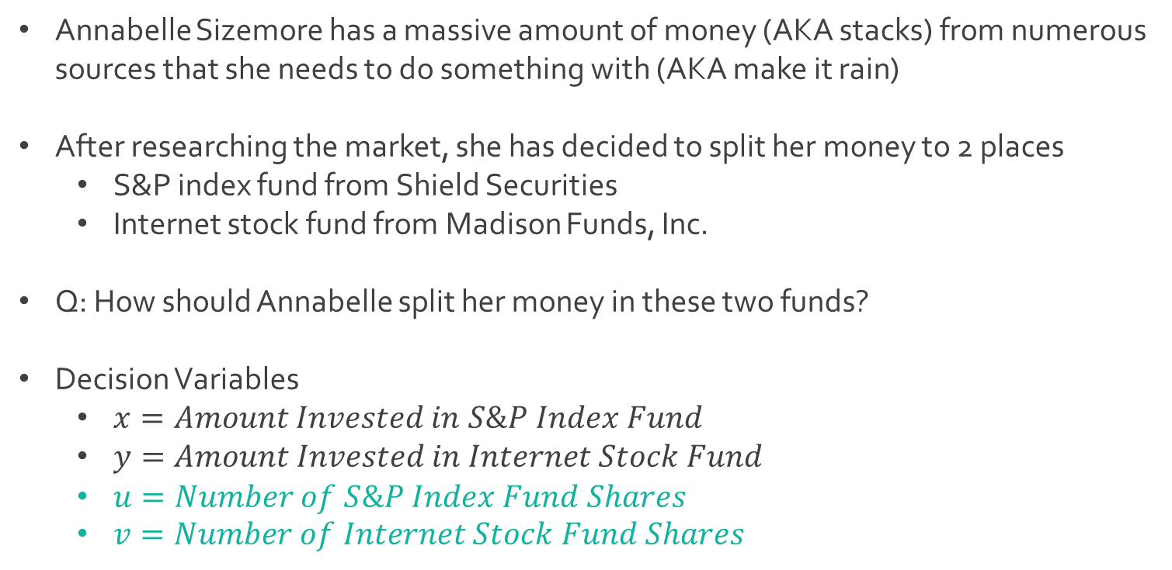
Ex: Annabelle Invests
Annabelle Sizemore has a massive amount of money (AKA stacks) from numerous sources that she needs to do something with (AKA make it rain)
After researching the market, she has decided to split her money to 2 places
S&P index fund from Shield Securities
Internet stock fund from Madison Funds, Inc.
Q: How should Annabelle split her money in these two funds?
Decision Variables
$x=Amount Invested in S\&P Index Fund$
$y=Amount Invested in Internet Stock Fund$
$u=Number of S\&P Index Fund Shares$
$v=Number of Internet Stock Fund Shares$

Slide 17
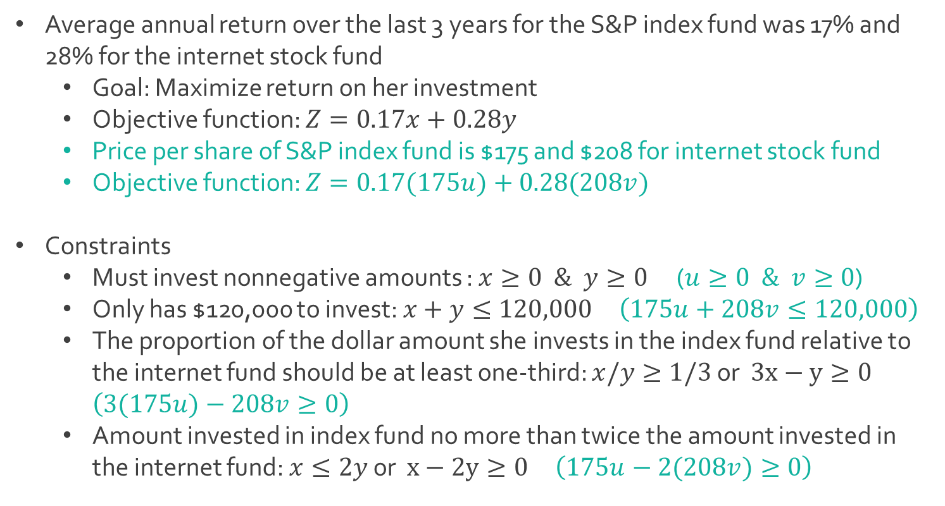
Ex: Annabelle Invests
Average annual return over the last 3 years for the S&P index fund was 17% and 28% for the internet stock fund
Goal: Maximize return on her investment
Objective function: $Z=0.17x+0.28y$
Price per share of S&P index fund is $175 and $208 for internet stock fund
Objective function: $Z=0.17(175u)+0.28(208v)$
Constraints
Must invest nonnegative amounts : $x≥0 \& y≥0$ ($u≥0 \& v≥0$)
Only has $120,000 to invest: $x+y≤120,000$ $\left(175u+208v≤120,000\right)$
The proportion of the dollar amount she invests in the index fund relative to the internet fund should be at least one-third: $x/y≥1/3$ or $3x−y≥0$ $\left(3(175u)−208v≥0\right)$
Amount invested in index fund no more than twice the amount invested in the internet fund: $x≤2y$ or $x−2y≥0$ $\left(175u−2(208v)≥0\right)$

Slide 18
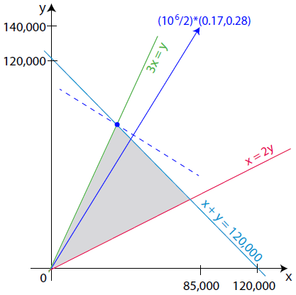
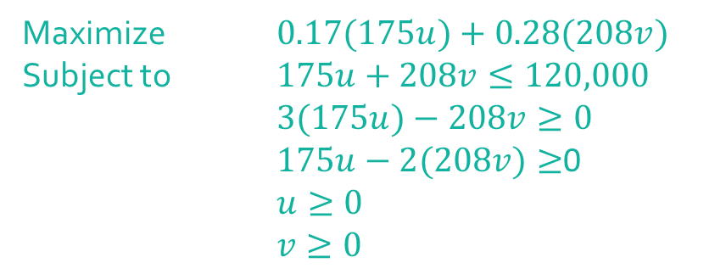
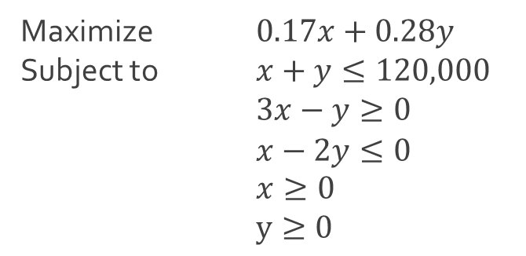
Ex: Annabelle Invests
Full linear program
Maximize $0.17x+0.28y$
Subject to $x+y≤120,000$
$3x−y≥0$
$x−2y≤0$
$x≥0$
$y≥0$
Maximize $0.17(175u)+0.28(208v)$
Subject to $175u+208v≤120,000$
$3(175u)−208v≥0$ $175u−2(208v)≥$0
$u≥0$
$v≥0$

Slide 19
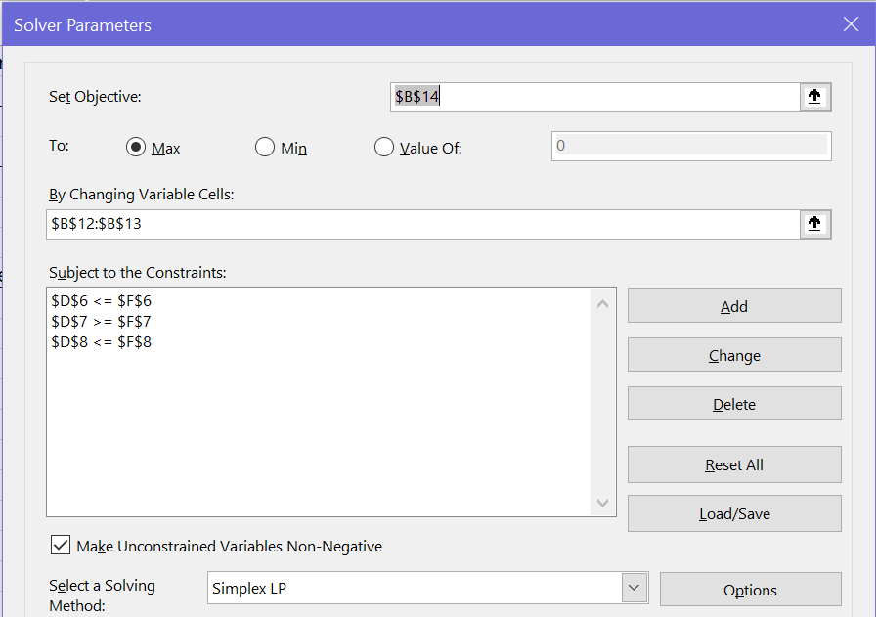
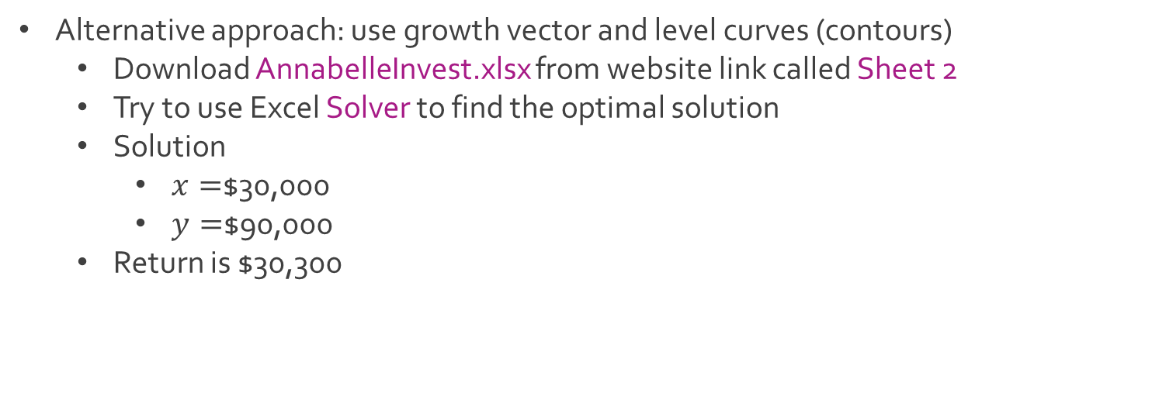
Ex: Annabelle Invests
Alternative approach: use growth vector and level curves (contours)
Download AnnabelleInvest.xlsx from website link called Sheet 2
Try to use Excel Solver to find the optimal solution
Solution
$x=$$30,000
$y=$$90,000
Return is $30,300

Slide 20




The End
Dale

